Slide 1







PowerShell Core Working With Python (Anaconda) & SQL Server Cross-platform
Maximo Trinidad
SAPIEN Technology Evangelist

Slide 2


Slide 3
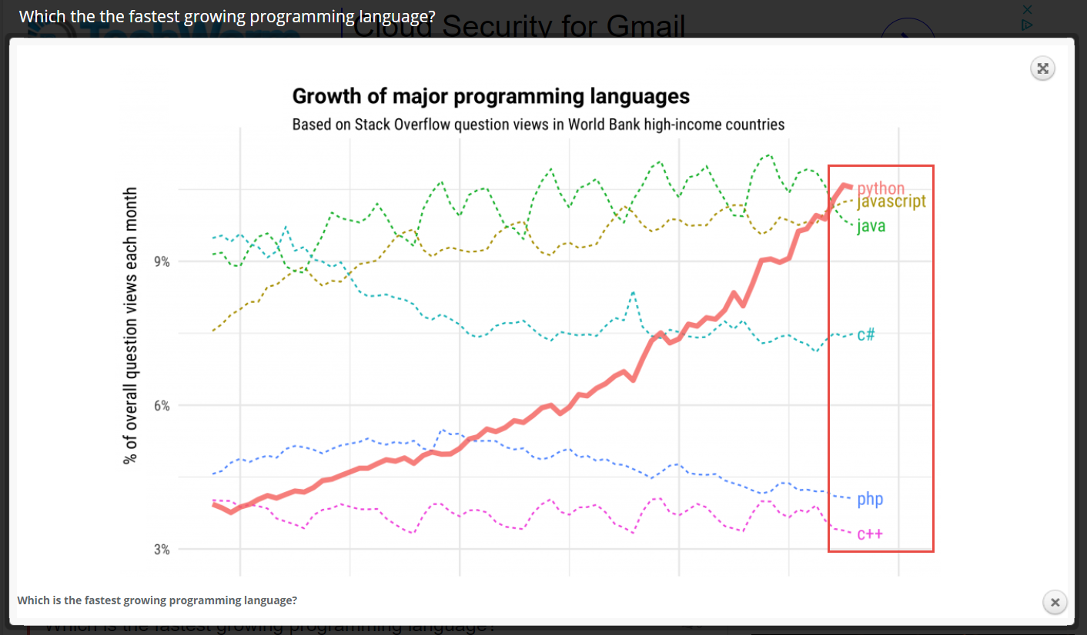
Top Demand Programming Languages
3
http://www.zdnet.com/article/javascript-rules-but-microsoft-programming-languages-are-on-the-rise/

Slide 4
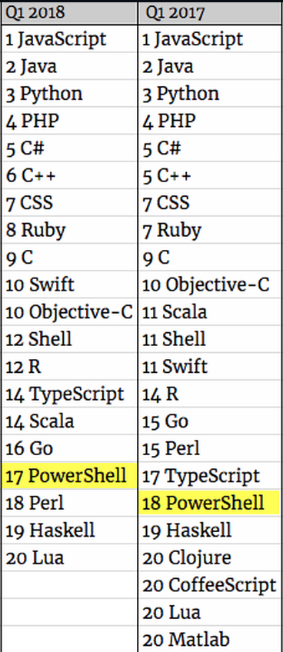
Top Demand Programming Languages

Slide 5
Agenda
1
1
Understanding Your Environment
2
PowerShell and SQL Server
3
Python SQL Connectors
4
Questions
5
Reference Information

Slide 6



Understanding Your Environment

Slide 7

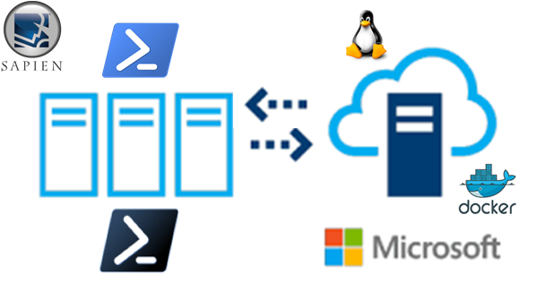



It’s All About Cross-platform Ecosystems

Slide 8
Understanding Your Environment
4
- Install component in both Windows and Linux Ubunbu
- PowerShell Core Open Source
- Linux SQL Server 2017 (GA)
- Linux and Windows OS use Anaconda Python 3.6
(Includes - Python Tcl/Tk & SQL Connectors)
- Install OpenSSH
- Install OMI (for WinRM)

Slide 9
Understanding Your Environment
5
You're New to Linux
Windows 10 Build 16299 (or Insider Preview)
Get WSL - “Ubuntu” from Microsoft Store
PowerShell Core 6.0.2
Anaconda (Python 3.6)
Cross-Platform Editor
VS Code lightweight Multi-language editor
VIM, GEDIT, EMACS24.
Enterprise-Level Editors
PrimalScript – Multi-language editor (Windows only)
PowerShell Studio
Building Virtual Machines:
Hyper-V
VMWare
Oracle VirtualBox
.
\

Slide 10
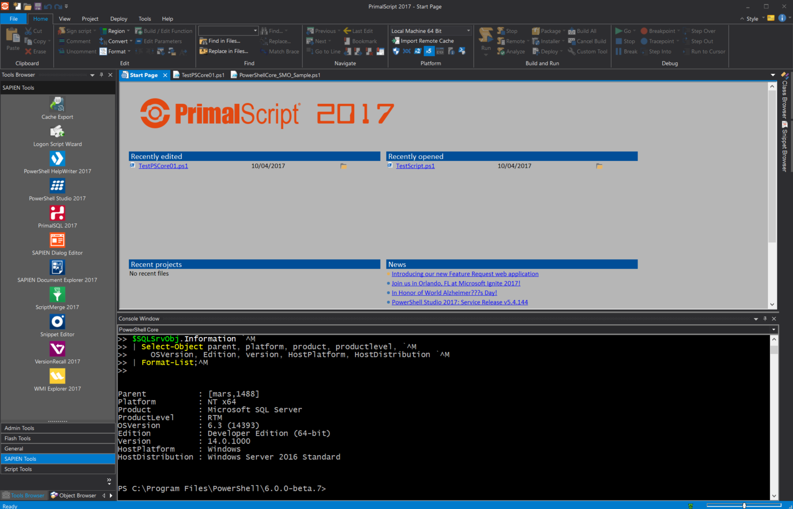
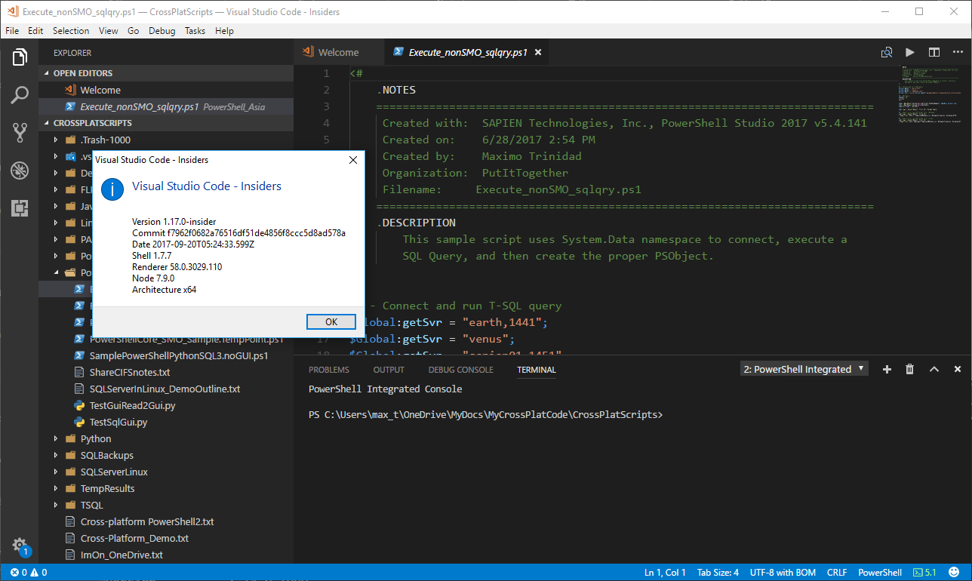
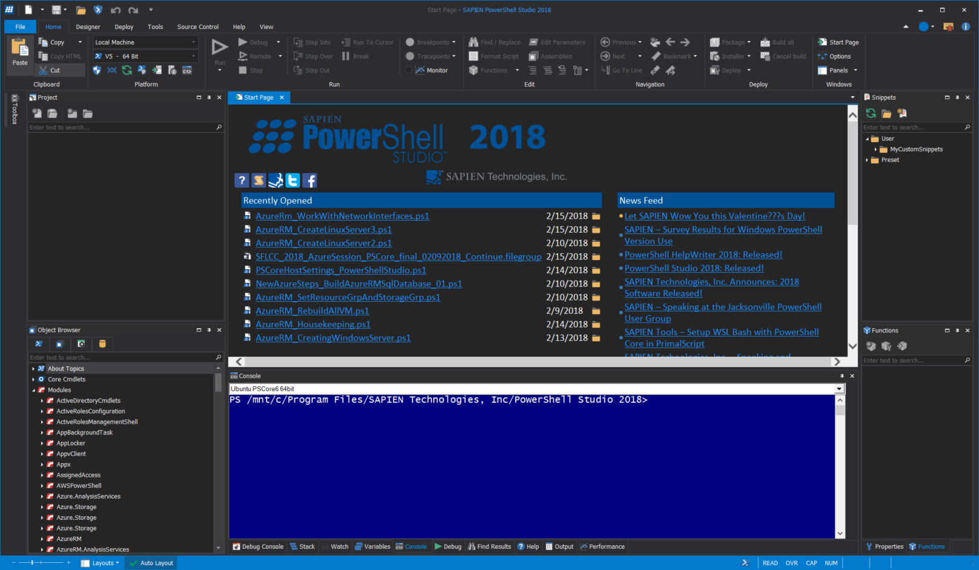
Understanding Your Environment

Slide 11
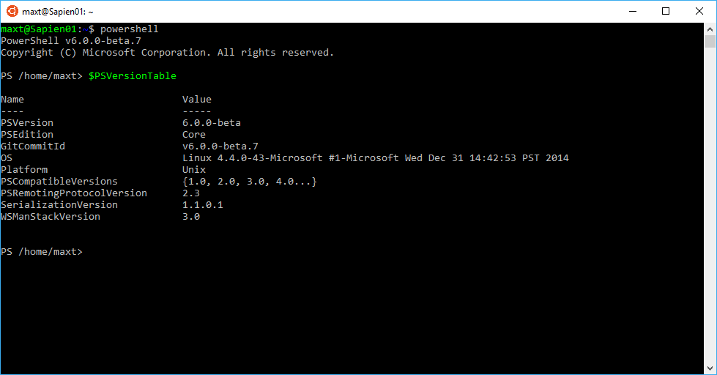
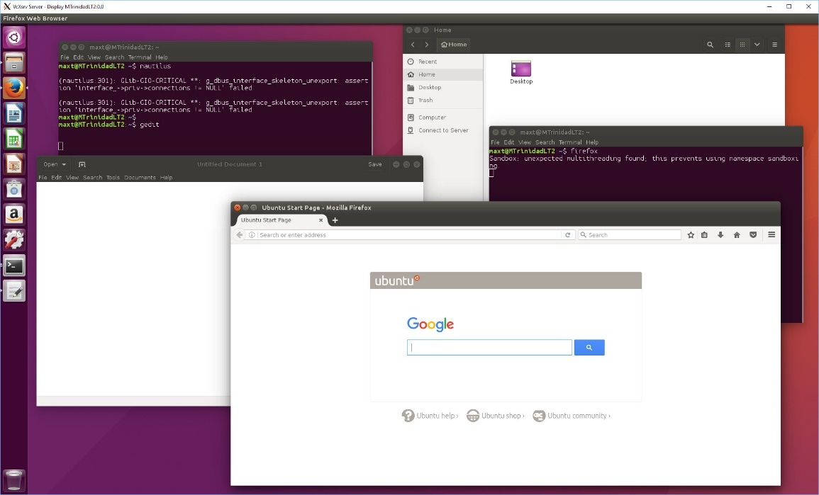
Windows 10 - Ubuntu
6

Slide 12
Understanding Your Environment
5
- SQL Server 2017 on Linux
- Version RTM (GA)
- Production Ready
- SQL Agent Available
-Full Text Search
- ODBC Connector available
- Azure SQL ready
- Use VS Code mssql extension
- No PowerShell SQLPS Commands available
- Use PowerShell Core with either:
- SMO (availability thru SQL Tools Service Layer in GitHub or NuGet)
- Use the ADO .Net - System.Data class (Included with PowerShell Core)

Slide 13
PowerShell and SQL Server
7
- SQL Server PowerShell scripting
- In Windows Only: (Windows PowerShell)
- Two PS Modules available:
* SQLPS (SQLServer installation)
* SQLServer (PowerShell Gallery for SSMS 17.4 or >)
- SMO (SQL Server Management Objects) in PowerShell Core
- Windows SQLPS/SQLServer modules will not execute
- .NET Core SMO installed from Nuget.
- .NET Core SMO will work in both Windows and Linux.

Slide 14
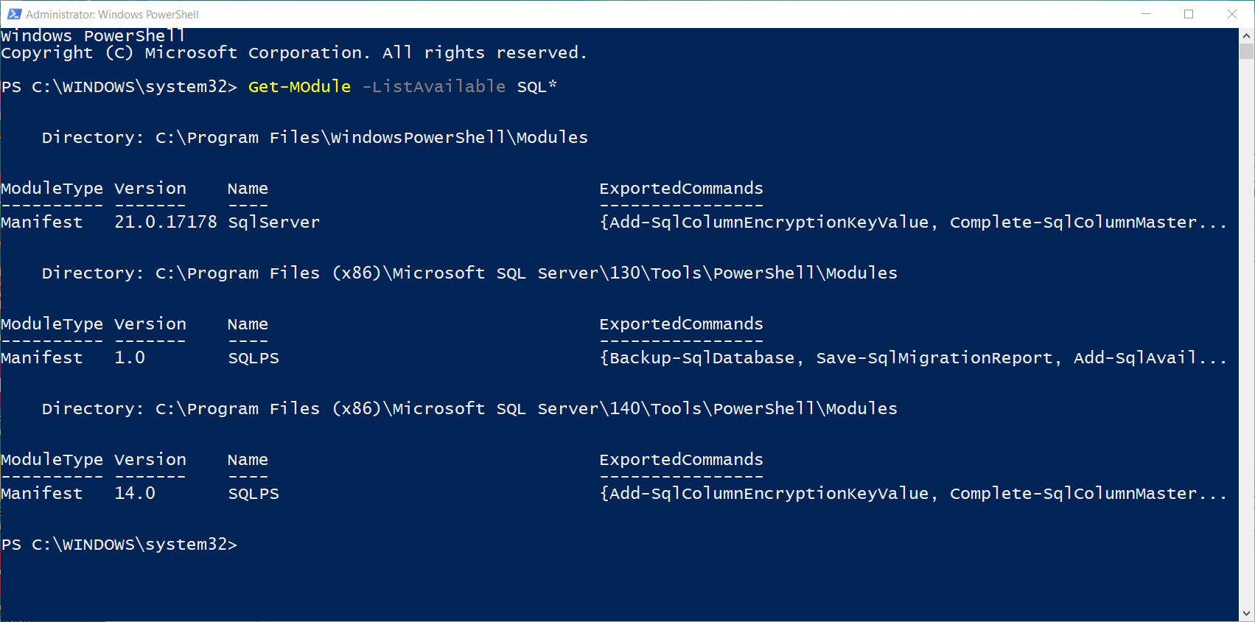
PowerShell and SQL Server

Slide 15
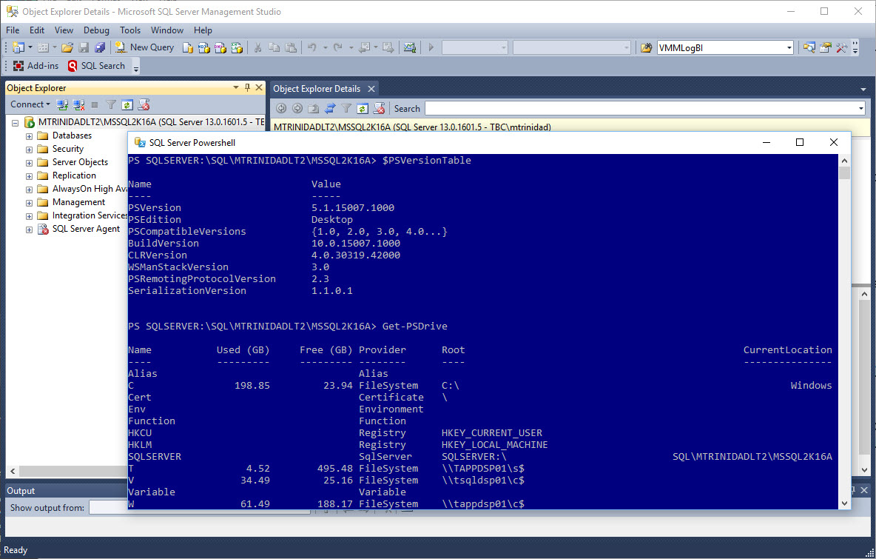
PowerShell and SQL Server
8

Slide 16
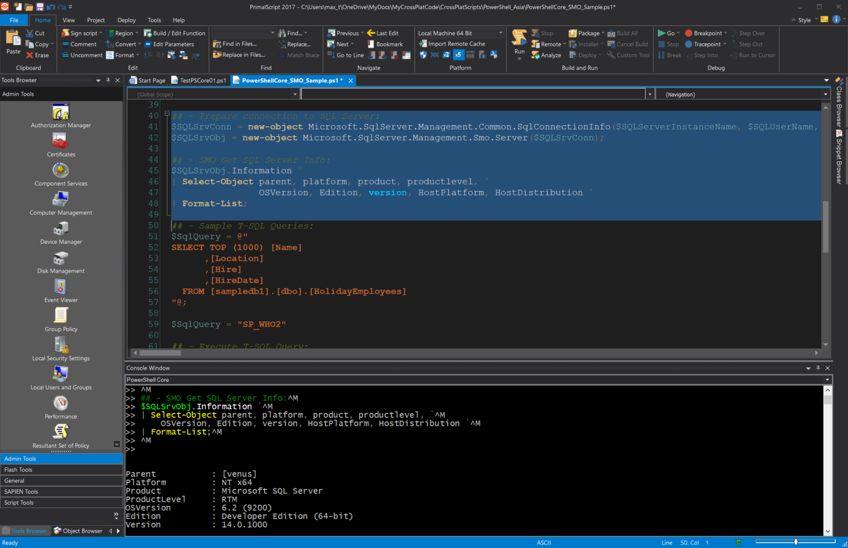
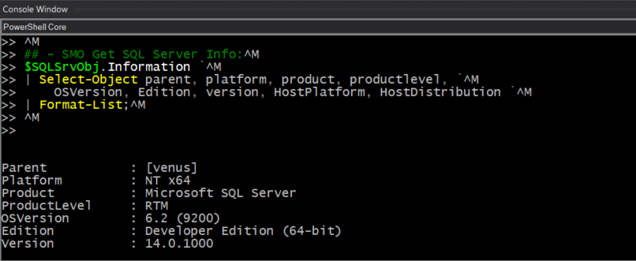

PowerShell and SQL Server
9

Slide 17
Connecting to SQL Server with Python
10
- Python Anaconda Installation
- Windows Installation is easy
- Download and install
- Linux installation:
- Download using wget command
- Then, install using bash command
## - Linux example:
~/cd Downloads
~/Downloads$ wget https://repo.continuum.io/archive/Anaconda3-5.0.1-Linux-x86_64.sh
~/Downloads$ bash Anaconda3-5.0.1-Linux-x86_64.sh

Slide 18
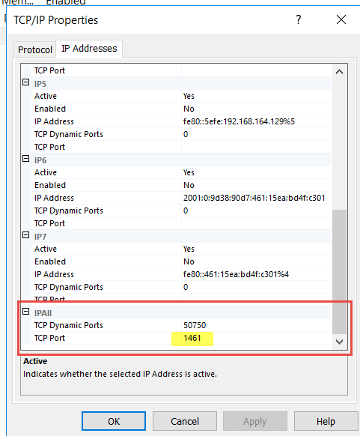
Connecting to SQL Server with Python
10
- Two SQL Connectors
- pyodbc (Included with Anaconda)
- pymssql (not covered)
- Connectors Behavior
- pyodbc and pymssql can connect to
- Windows local and
Multi-instance SQLServer
- Linux only single instance
*SQL Server Default Port: 1433

Slide 19
Connecting to SQL Server with Python
What it brings to the table:
Python with PowerShell
- Data collection, and Tasks automation
- Possibility of Cross-platform solutions
- Take advantage of .NET objects in Linux
- Build solutions for both On-Premise, Azure Hybrid and Cloud

Slide 20
Python and SQL Server
- SQL Server 2017 Python Integration (Windows Only)
- Only a subset of Anaconda
1. Enabled External Scripts: (T-SQL)
sp_configure 'external scripts enabled', 1
Reconfigure
(Restarting SQL Server Services needed)
2. Run Test in SQL Query Panel:
execute sp_execute_external_script
@language = N'python',
@script = N'
import sys
print("Hello SQLServer, I am Python Version:")
print(sys.version)
‘

Slide 21
Python and SQL Server
- SQL Server 2017 Python Integration (Windows Only)
- Caveats
The following error will happen due to the SQL Server working folder path having spaces:
“HResult 0x9864, Level 16, State 1
Unable to communicate with the runtime for 'Python' script. Please check the requirements of 'Python' runtime.”
Resolution:
Fix working folder path in both the pythonlauncher.config and rlauncher.config files (no spaces):
Change:
WORKING_DIRECTORY=C:\Program Files\Microsoft SQL Server\MSSQL14.MSQL2K17SAT\MSSQL\ExtensibilityData
To:
WORKING_DIRECTORY=C:\Progra~1\Micros~1\MSSQL14.MSQL2K17SAT\MSSQL\ExtensibilityData

Slide 22
Demo
11
1. Using you tools
SAPIEN Tools, PoweShell Core, Anaconda Python 3.6.x
SSMS – Windows & Linux connectivity (** SQL Authentication only **)
Carbon and MSSQLscripts
*Note: dos2unix –k *.* (text code converter win2linux format)
2. PowerShell Getting SQL Results
Execute_nonSMO_sqlqry.ps1
PowerShellCore_SMO_Sample.ps1
3. Python 3.6 (Anaconda)*
TestGuiRead2Gui.py
TestSqlGui.py
4. Python/PowerShell Integration:
SamplePoweShellPythonSQL3_nogui.ps1
Function Out-CsvToGridView.ps1

Slide 23
Reference Information
13
PowerShell Open Source: https://github.com/PowerShell/PowerShell
Windows PowerShell bugs use UserVoice: https://windowsserver.uservoice.com/forums/301869-powershell
Python SQL Server ODBC connector (pyodbc): https://github.com/mkleehammer/pyodbc
Bash for Windows 10: https://blogs.msdn.microsoft.com/commandline/learn-about-bash-on-windows-subsystem-for-linux/
https://blogs.msdn.microsoft.com/commandline/2016/11/17/do-not-change-linux-files-using-windows-apps-and-tools/
What is Anaconda: https://www.anaconda.com/what-is-anaconda/
Python 3.6 Anaconda in SQL Server 2017: https://blogs.technet.microsoft.com/dataplatforminsider/2017/04/19/python-in-sql-server-2017-enhanced-in-database-machine-learning/
PowerShell, and SQL Server Working with Anaconda
http://www.maxtblog.com/2017/05/powershell-and-sql-server-working-with-anaconda/
Windows 10 Bash and PowerShell Redux
http://www.maxtblog.com/2017/01/windows-10-bash-and-powershell-redux/
Microsoft blog - MVP Award program Blog:
https://blogs.msdn.microsoft.com/mvpawardprogram/2017/05/26/friday-five-may-26th/?wt.mc_id=DX_883076
https://blogs.msdn.microsoft.com/mvpawardprogram/2017/03/10/friday-five-march-10th/
https://blogs.msdn.microsoft.com/mvpawardprogram/2017/02/17/friday-five-feb-17th/
https://blogs.msdn.microsoft.com/mvpawardprogram/2016/12/23/friday-five-dec-23/
MSSQLTips
Unable to communicate with the runtime for 'R' script in SQL Server (applies to Python)
https://www.mssqltips.com/sqlservertip/4557/unable-to-communicate-with-the-runtime-for-r-script-in-sql-server/

Slide 24


Questions
12

Slide 25
Contact information:
Maximo Trinidad
Technology Evangelist
Email: maxt@sapien.com
Office: 707-501-4224 x. 115
SAPIEN Technologies MVP 2017
IDERA ACE member 2017
Blog: http://www.maxtblog.com/
Twitter: @maxtrinidad
Microsoft MVP - Cloud and Datacenter Management

